Slide 1

Building a group video calling application
Learning the basics of Agora Web SDK, and creating a video calling application using it.

Slide 2
Prerequisite
Basics of HTML and CSS
Basic JS
Notes:
Maybe a quick recap of the last session?

Slide 3
Learning
Outcome
Advanced JavaScript
Agora’s Web SDK
Using API’s and documentation

Slide 4
Project
AUDIOVISUAL
INTERACTIVE
DYNAMIC
Adding group video calling to your web application.
Control users in a call using functions like : mute, disable camera, rotating the camera, disconnecting the call.
Creating a layout that adjusts automatically based on the number of users.

Slide 5
Project Assets
Images
Agora SDK
https://www.agora.io/en/wp-content/uploads/2019/06/agoralightblue-1.png
https://docs.agora.io/en/Agora%20Platform/downloads
Tailwind CSS
Google Developer
https://tailwindcss.com/
https://console.developers.google.com

Slide 6
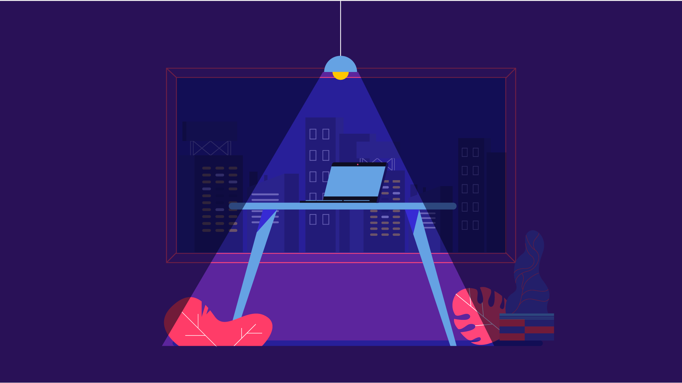
AVC
Agora Video Call

Slide 7
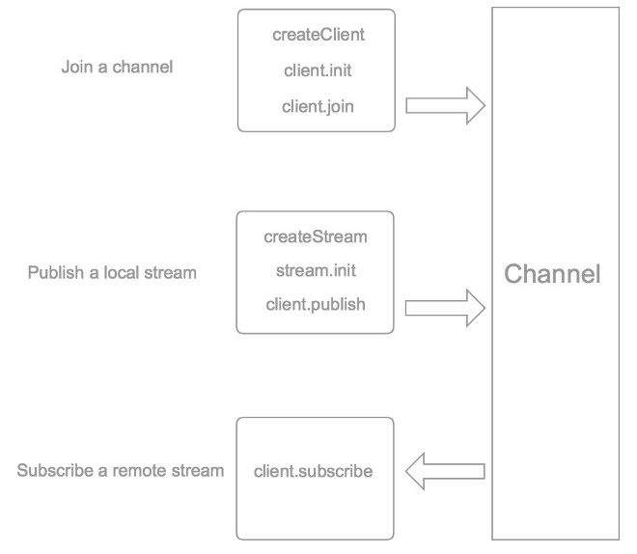
Notes:
Architecture

Slide 8
Creating an APP ID
Notes:
Go to https://console.agora.io/

Slide 9
Homework
Try to rebuild a video chat app on your own
Review the Agora QuickStart guide on the Agora Documentation site (https://docs.agora.io/en/Video/start_call_web?platform=Web)
Notes:
Go to https://console.agora.io/

Slide 10


THANKS!
Meherdeep Thakur
Agora Superstar
meherdeept@gmail.com

